Slide 1
Intelligent Phishing URL Detection System Using Machine Learning and GUI
S akshay kumar – ra2331021020046
HARIKRISHNAN R – ra2331021020008

Slide 2
Abstract
Phishing attacks are one of the most common cyber threats, where attackers trick users into revealing sensitive information through malicious URLs. This project presents an Intelligent Phishing URL Detection System that uses machine learning and heuristic analysis to classify URLs as phishing or legitimate.
The system extracts lexical features, URL structure patterns, and TF-IDF based textual features, and applies an ensemble learning model consisting of Logistic Regression, Random Forest, Support Vector Machine, and XGBoost (if available).
A Tkinter-based GUI allows users to train the model, load/save trained models, and check URLs in real time. The system is designed to handle class imbalance, small datasets, and supports WHOIS-based domain age analysis for improved accuracy.

Slide 3
System Overview
System Description
User-friendly GUI for phishing detection
Automated dataset download and preprocessing
Feature extraction from URLs
Ensemble machine learning classification
Real-time URL prediction with probability score
Model persistence using Joblib

Slide 4
Technologies Used
Language: Python
Libraries: Scikit-learn, Pandas, NumPy, Tkinter
ML Models: Logistic Regression, Random Forest.
Feature Engineering: TF-IDF, Lexical URL Features
Dataset Sources: Online Phishing & Legitimate URL Repositories

Slide 5
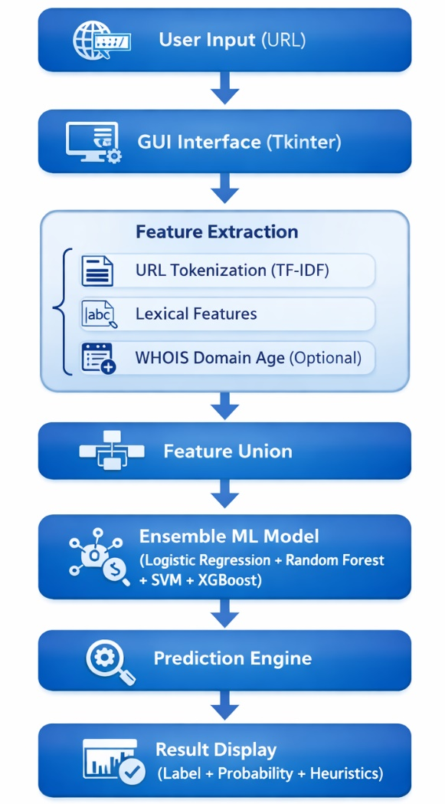
Architectural Design

Slide 6
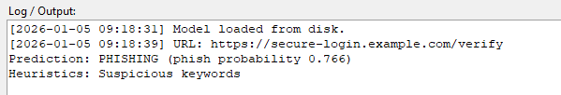
Results & Performance Evaluation
Performance Highlights
Ensemble model improves detection accuracy
TF-IDF + lexical features increase robustness
Balanced class weights reduce false negatives
Real-time URL prediction with probability score
Output Example

Slide 7
THANK YOU!

